Slide 1
Organizational Measures Project
Eddie Zare

Slide 2
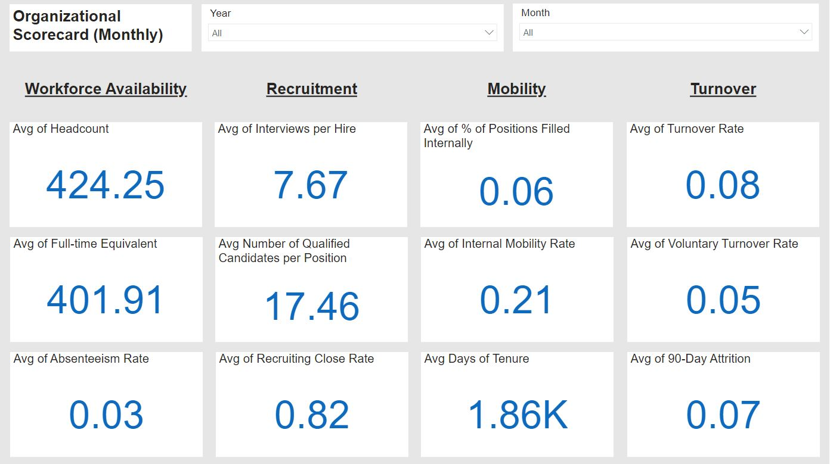
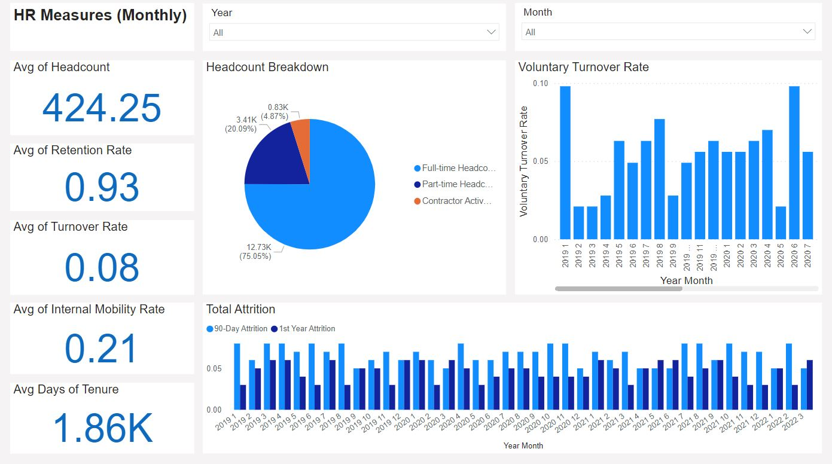
Organizational Measures Dashboard
Organizational Scorecard
Gives user a quick glance into 12 common measures across key categories
HR Measures
Overview of Human Resources data
Quick look metrics on the left-hand side
Headcount breakdown shows employee types (full-time, part-time, etc.)

Slide 3
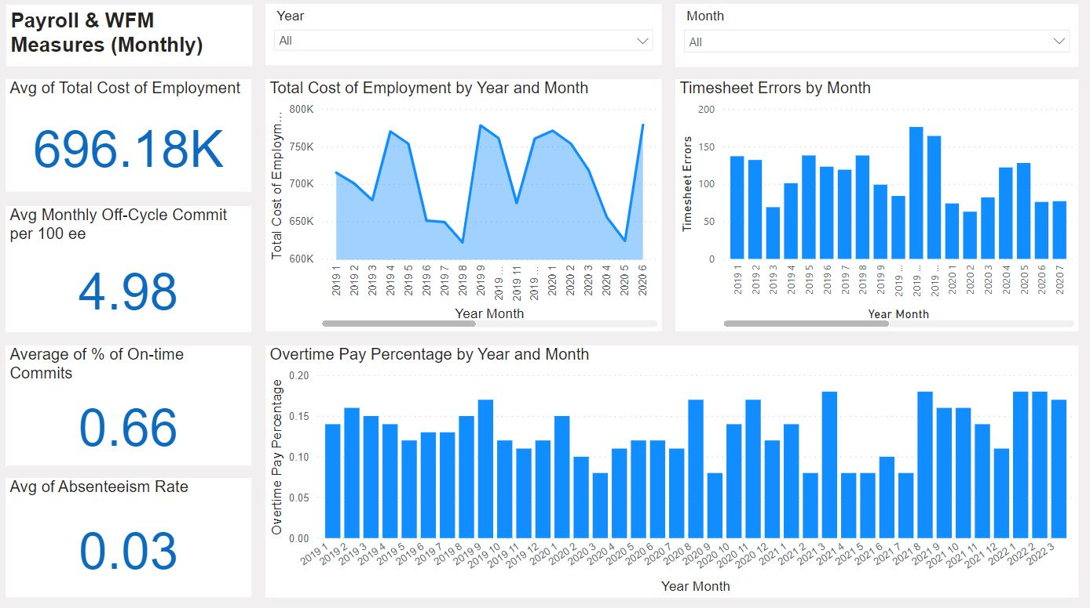
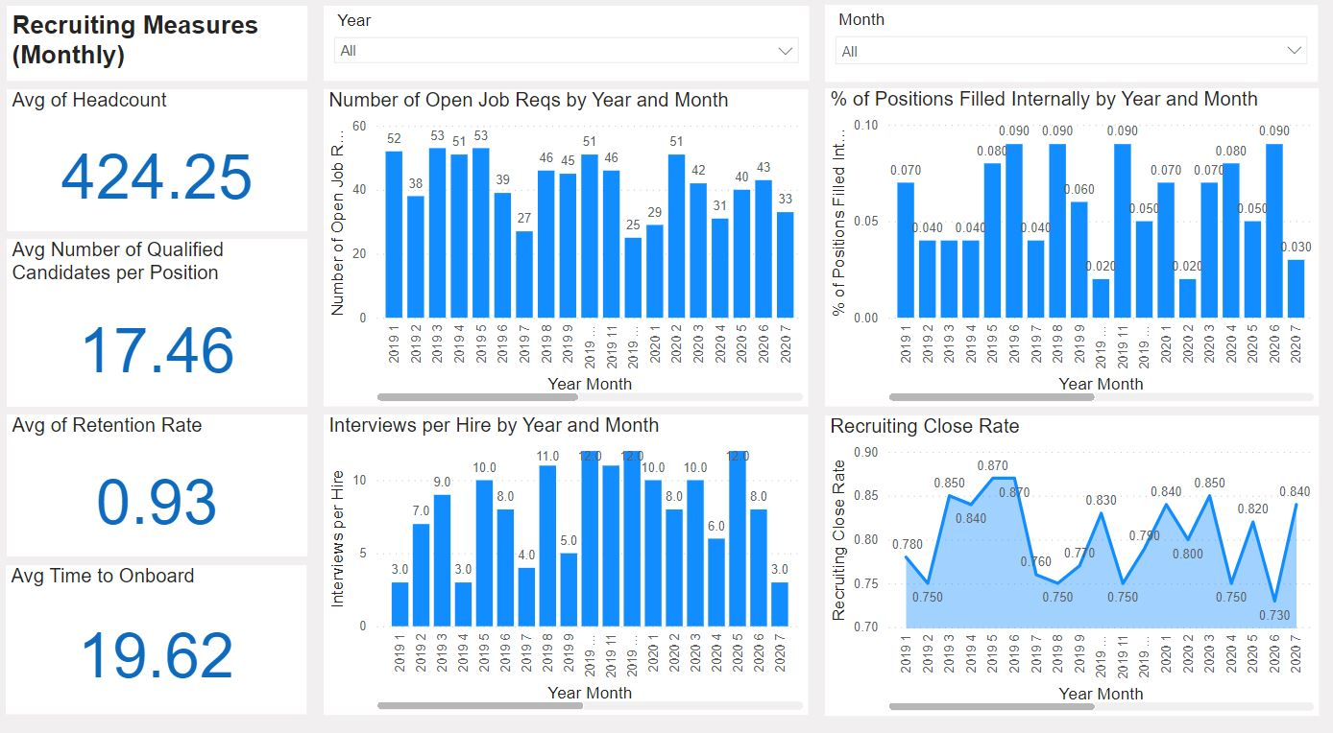
Organizational Measures Dashboard Cont.
Payroll & WFM Measures
Data visualization view for Payroll/WFM
Pre-built visualizations to anticipate user needs (Overtime Pay, timesheet errors, etc.)
Recruiting Measures
Overview of Recruiting data
Each page has quick look metrics on the left-hand side
User can edit any element in the report (swap out measures, change visual, etc.)

Slide 4




Organizational Measures Dashboards
Pre-built visualizations on each page
Synced slicers to filter through data
Quick look metrics on the left-hand side on each page
The Scorecard page (above) gives the user a quick glance into 12 common measures across key categories
User can copy report to edit any element in the dashboard (swap measures, change visual, etc.)​

